Slide 1
Create attribute view.
Milind Parab

Slide 2
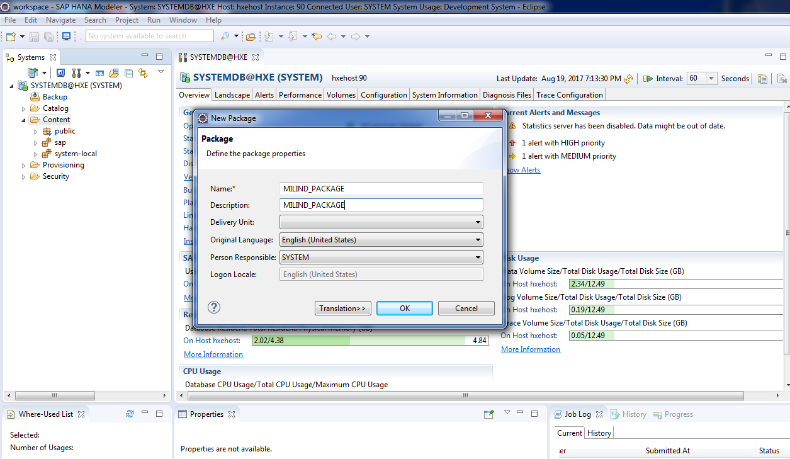
Create a Package.

Slide 3
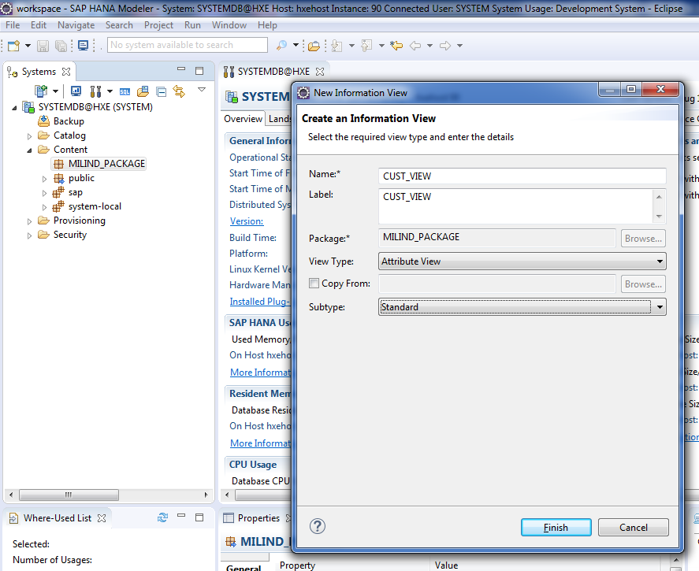
Cont.

Slide 4
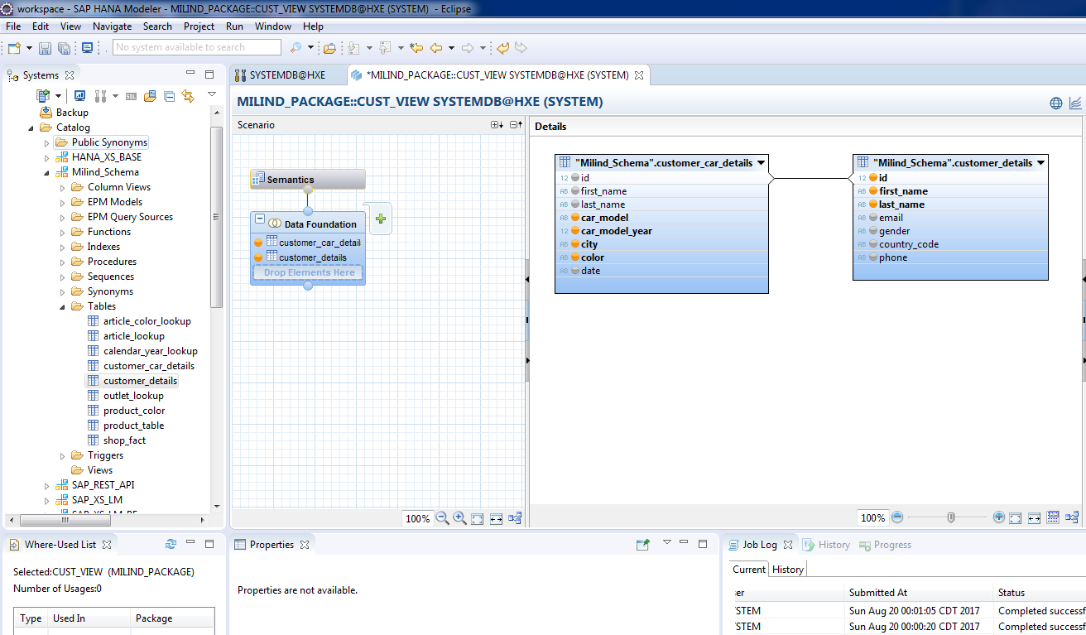
Drag and drop customer details and customer car details tables.

Slide 5
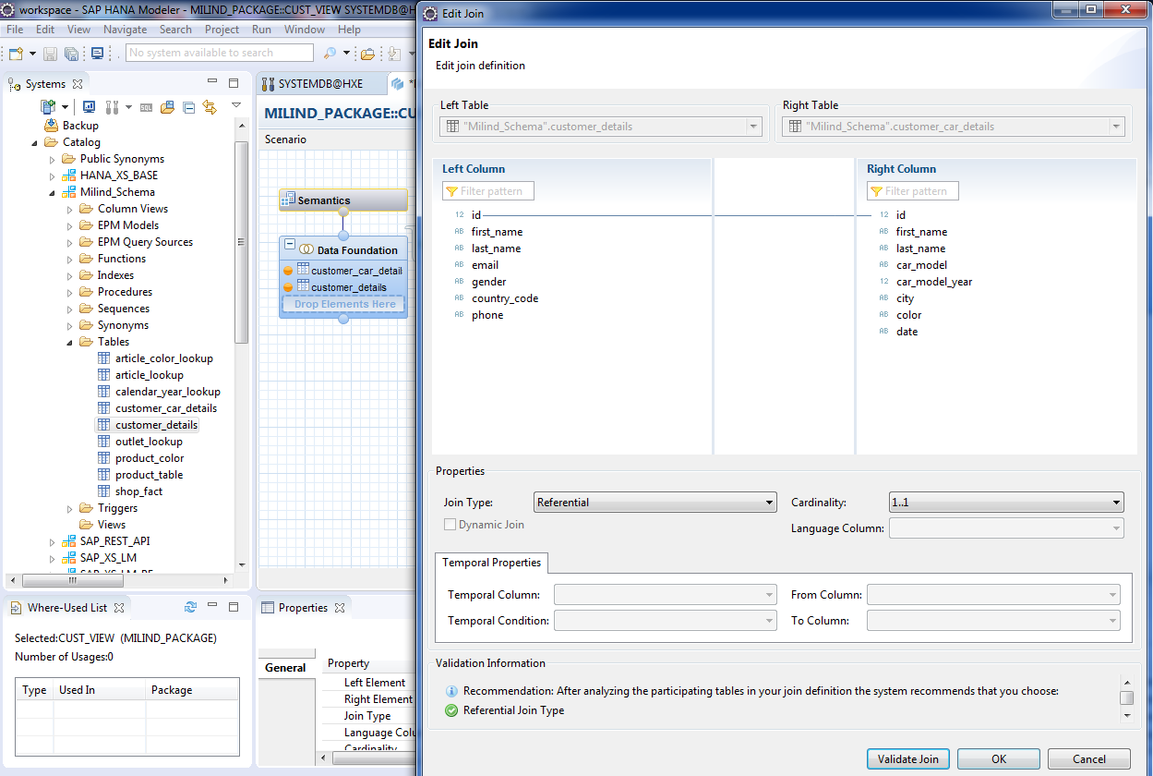
Specify join type and cardinality.

Slide 6
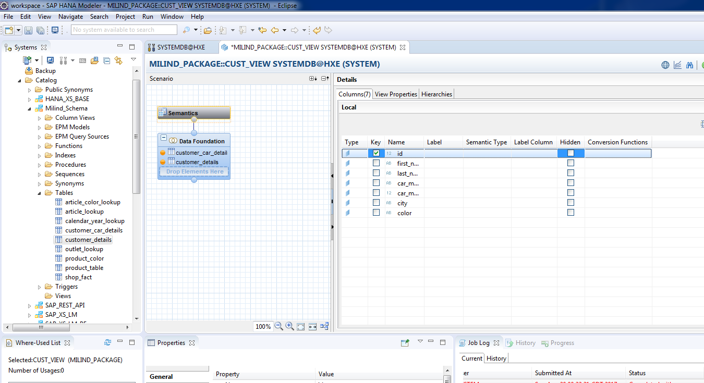
Go to semantic and specify the key.

Slide 7
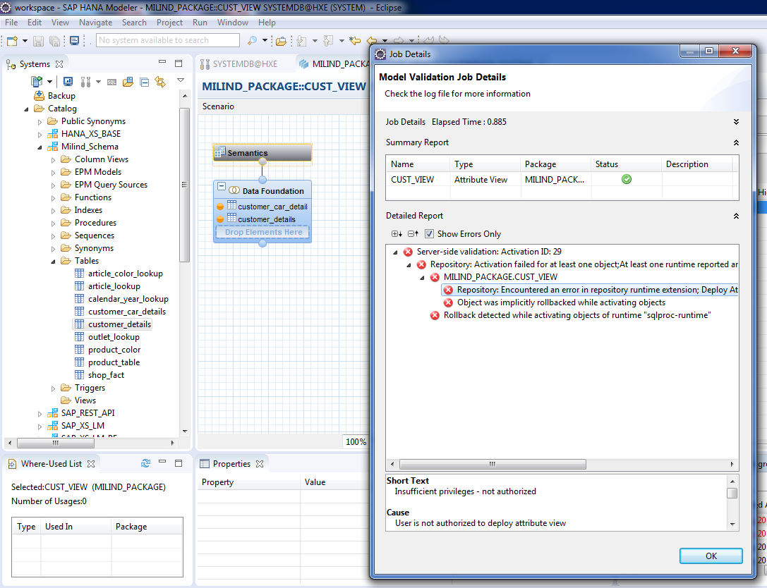
Let’s resolve insufficient authorization error.

Slide 8
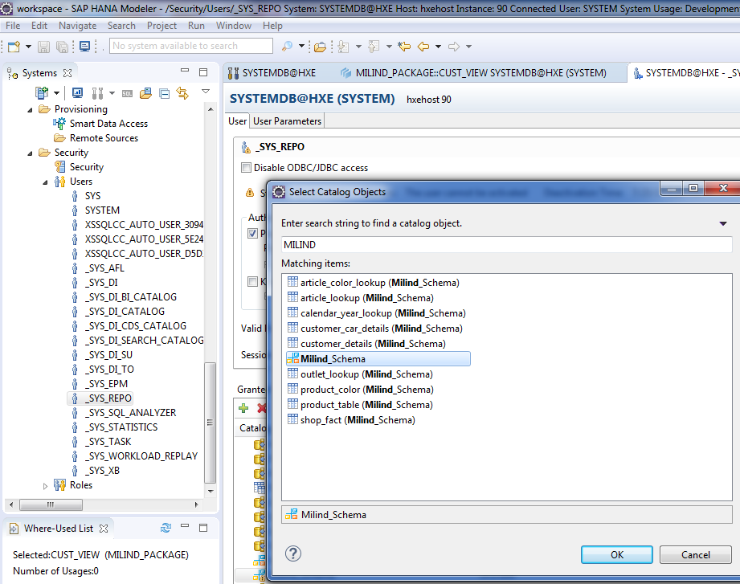
Add MILIND_SCHEMA.

Slide 9
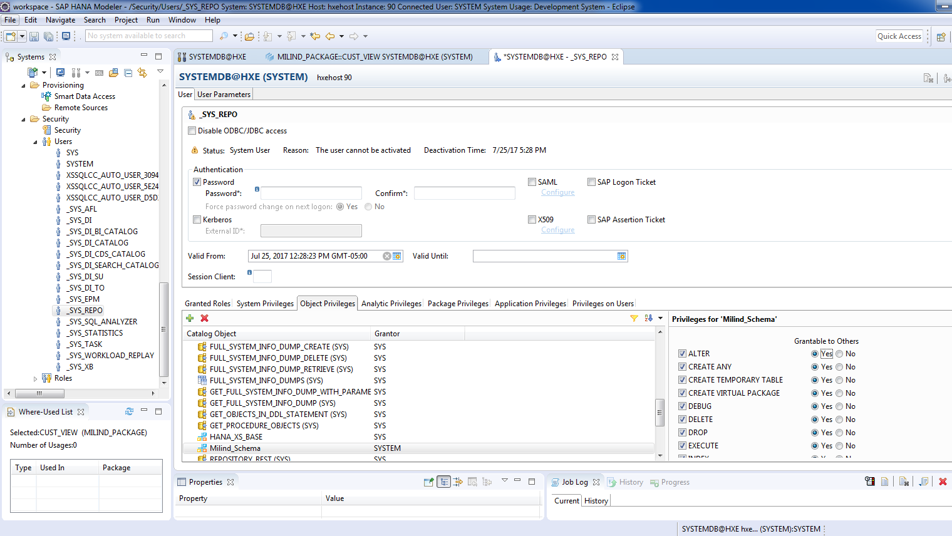
Assign all privileges.

Slide 10
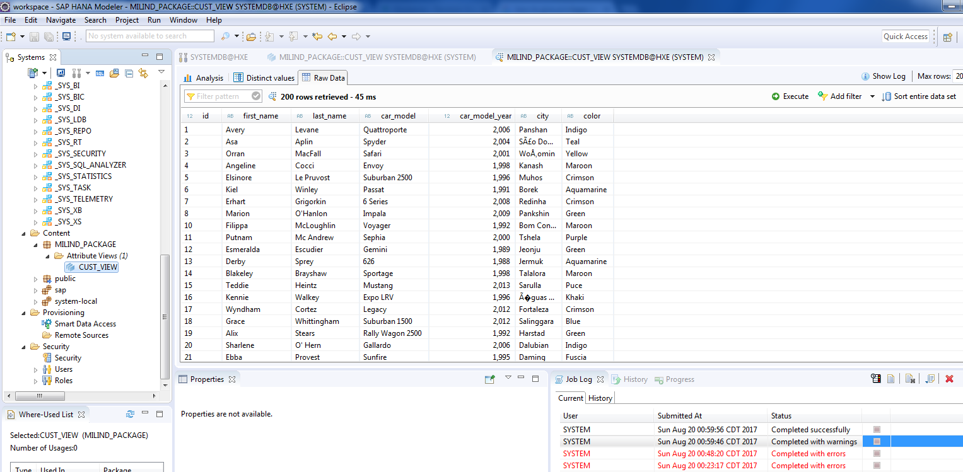
Validate and activate the view.

Slide 11
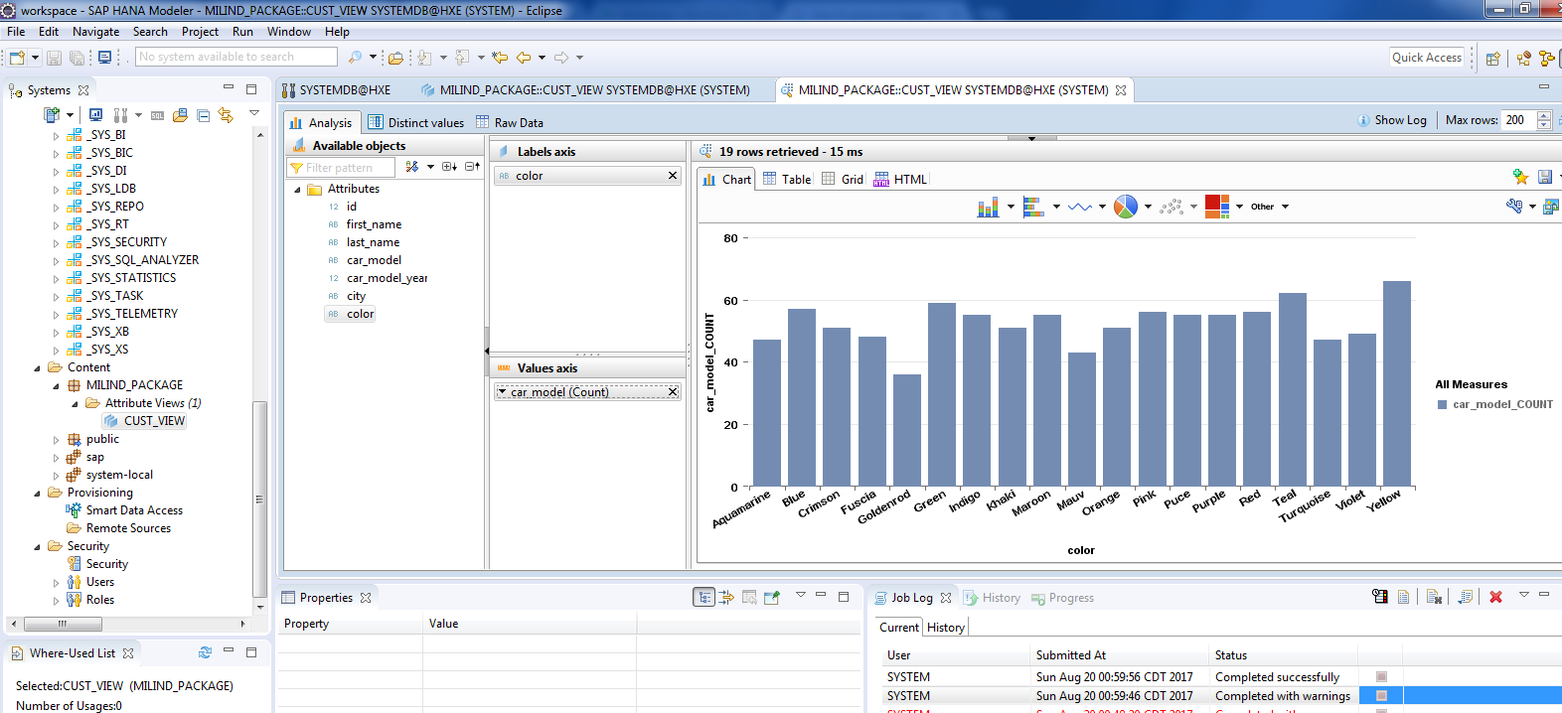
Cont.

